Slide 1

RAGHU ENGINEERING COLLEGE
(AUTONOMOUS)
DEPARTMENT OF EEE
Academic year: 2018-2019
II year 2-semister
CONTROL SYSTEMS
CASE STUDY
ON
TIME RESPONSE OF FIRST ORDER ELECTRICAL CIRCUIT FOR COMBINATION OF STEP AND SINUSOIDAL INPUT.
FACULTY:
Mrs. K.Sulochana
Associate professor
BATCH-3
18985A0246 – K.Karthik
18985A0247 – L.Ratnakara Rao
18985A0248 – M.Gaddim Naidu
18985A0249– M.Jagapathi varma
18985A0250 – M.Sai

Slide 2
Introduction:
There are two methods to analyze functioning of a control system that are time domain analysis and control domain analysis. In time domain analysis the response of a system is a function of time. It analyzes the working of a dynamic control system. This analysis can only be applied when nature of input plus mathematical model of the control system is known. It is not easy to express the actual input signals by simple equations as the input signals of the control systems are not fully known. There are two components of any system’s time response, transient response and steady response.
First order system
Introduction to First-Order Systems 1
The system whose input-output equation is a first order differential equation is called first order system. The order of the differential equation is the highest degree of derivative present in an equation. First order system contains only one energy storing element. Usually a capacitor or an inductor is used for this purpose.
Most of the practical models are first order systems. If a system with higher order has a dominant first order mode it can be considered as a first order system.
Time Response: the output of a control system for an input varies with respect to time, then it is called time response of the system.
Time response consists of two parts transient response and steady state response .

Slide 3
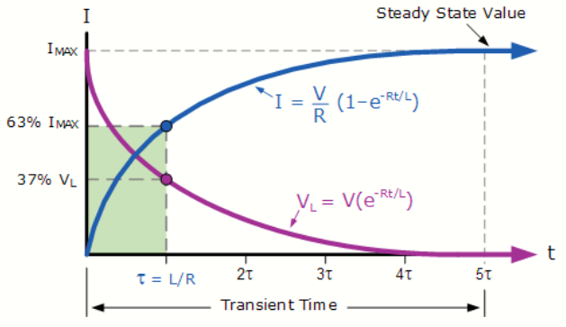
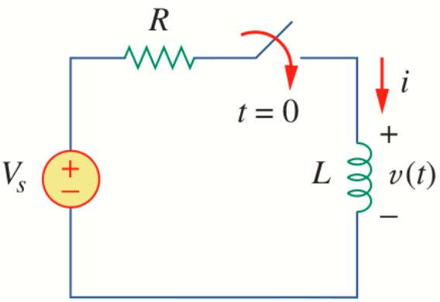
Time Response Overview The time response represents how the state of a dynamic system changes in time when subjected to a particular input. Since the models we have derived consist of differential equations, some integration must be performed in order to determine the time response of the system. For some simple systems, a closed-form analytical solution may be available. However, for most systems, especially nonlinear systems or those subject to complicated inputs, this integration must be carried out numerically. Fortunately, MATLAB provides many useful resources for calculating time
The time response of a linear dynamic system consists of the sum of the transient response which depends on the initial conditions and the steady-state response which depends on the system input. These correspond to the homogenous (free or zero input) and the particular solutions of the governing differential equations, respectively.
RL circuit and response :

Slide 6
Response of RL circuit for sinusoidal input

Slide 7
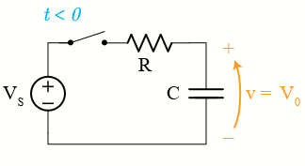
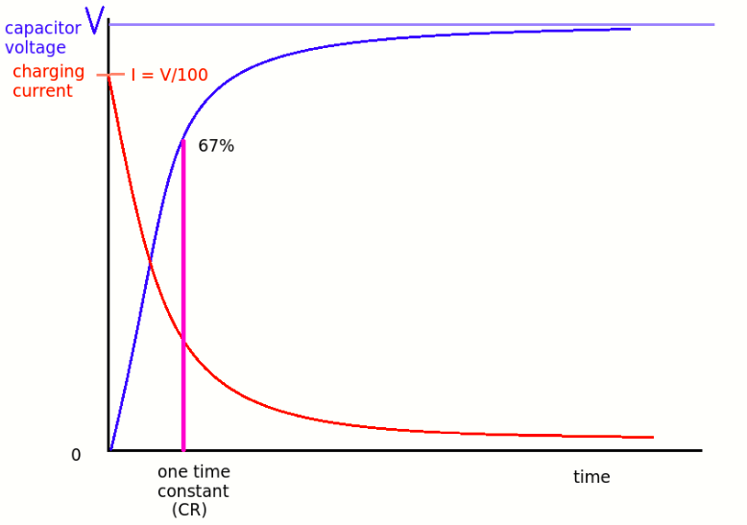
RC circuit and response :

Slide 9
Response of RC circuit for sinusoidal input

Slide 10
Conclusion:
After learning all things related to 1st order control system, we come to the following conclusions
A pole of the input function generates the form of the forced response. It is because of pole at the origin which generates a step function at output.
A pole of the transfer function generates the natural response. It the pole of the system.
A pole on the real axis generates an exponential frequency of the form e-at. Thus, the farther the pole to the origin, the faster the exponential transient response will decay to zero.
Using poles and zeros, we can speed up the performance of system and get the desired output.

